Slide 1
Crash course in lung development
LungMAP Data+
Lab Meeting June 2 2016

Slide 2
Adult respiratory system

Slide 4
Branching morphogenesis

Slide 5
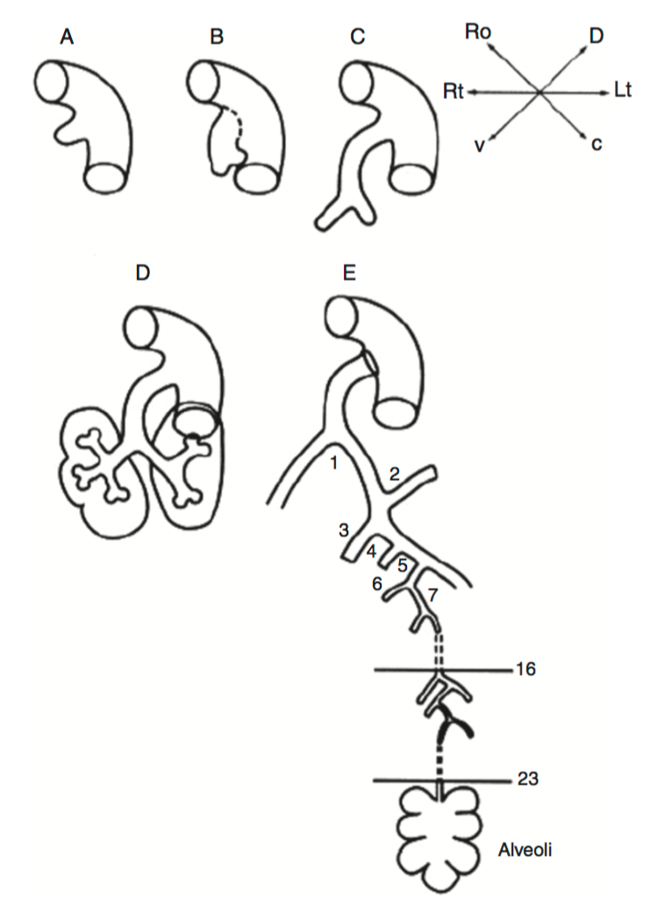

Slide 6
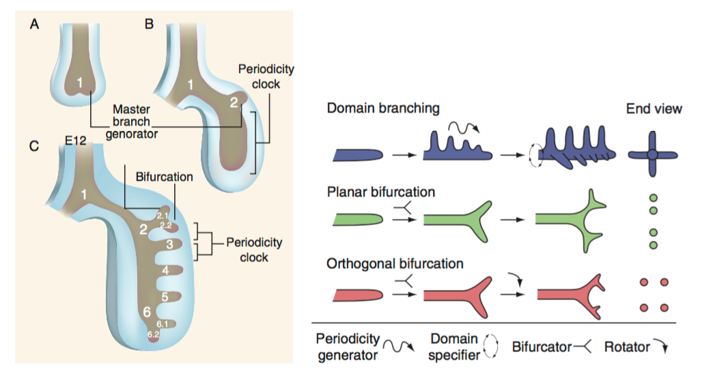

Slide 7
Stages of lung development

Slide 8
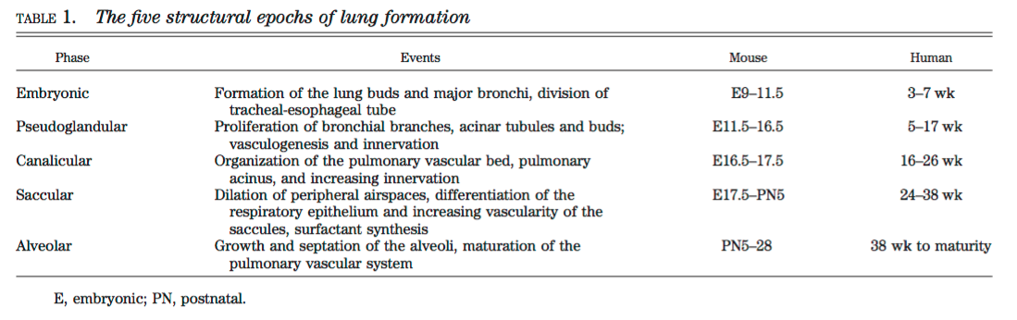

Slide 9
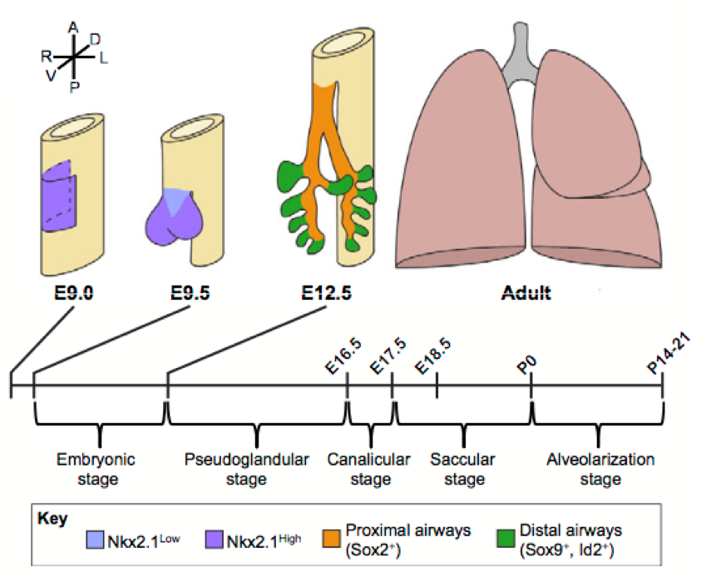

Slide 10
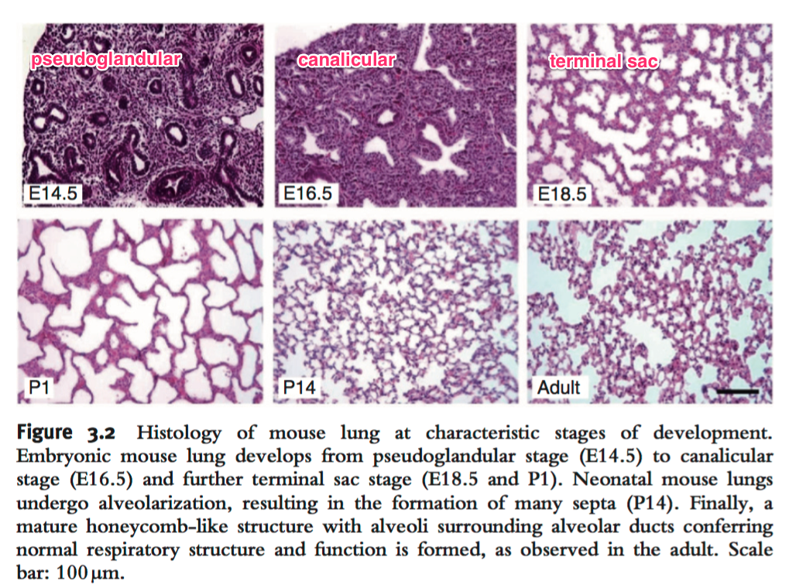

Slide 11
Transcription factor regulation

Slide 12
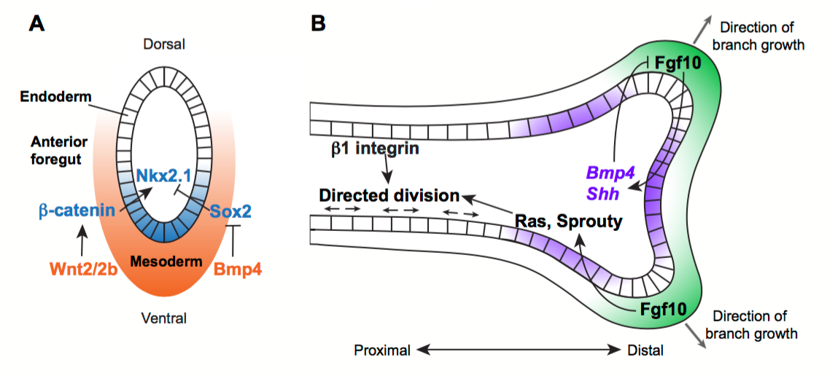

Slide 13
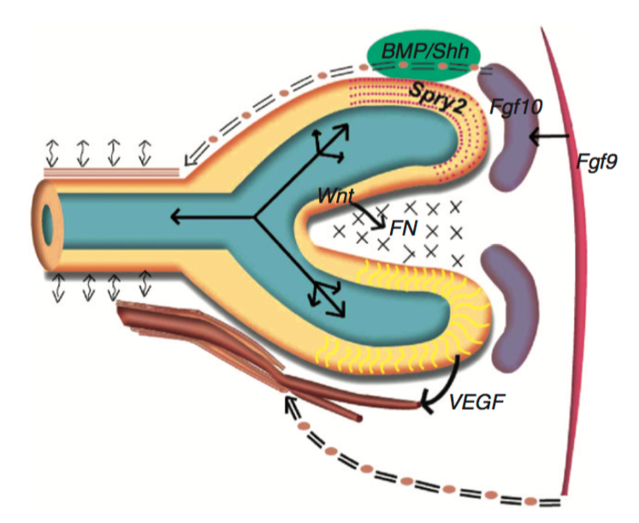

Slide 14
Origin of different cell types

Slide 15
Stem cell biology
Tracheal and bronchial epithelial progenitors
Alveolar epithelial progenitors
Smooth muscle progenitors
Vascular progenitors
Immune cells

Slide 16
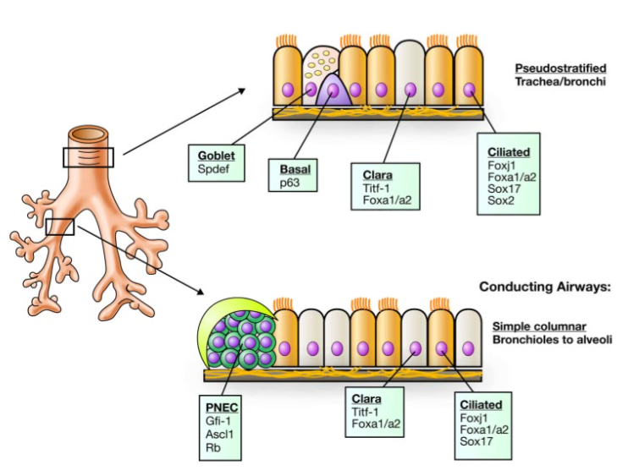

Slide 17
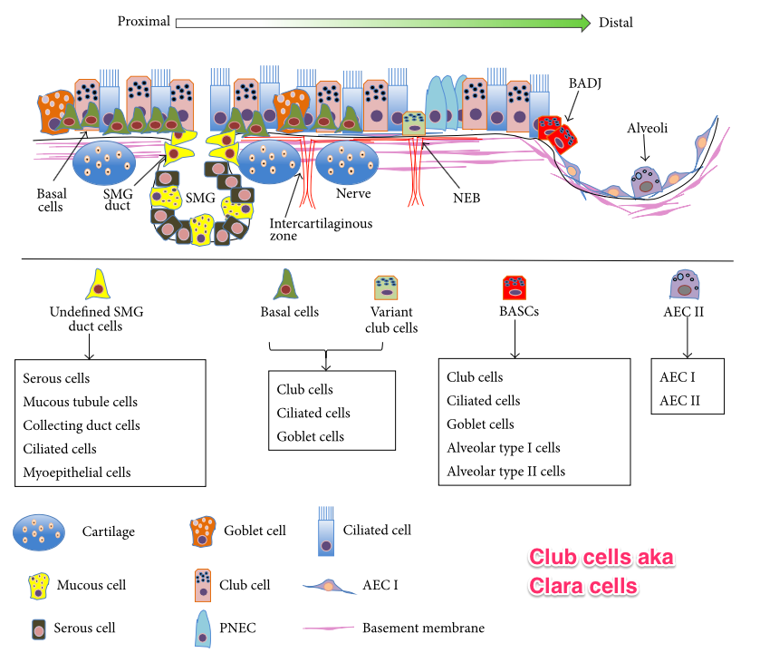

Slide 18
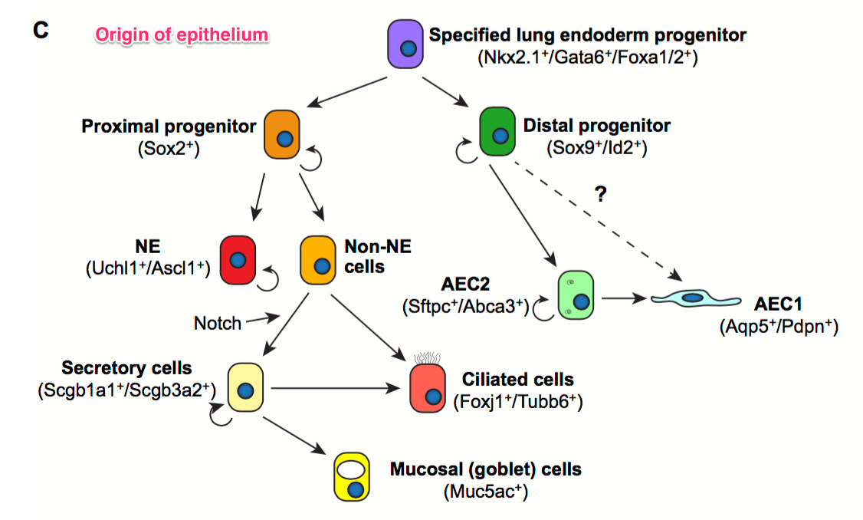

Slide 19
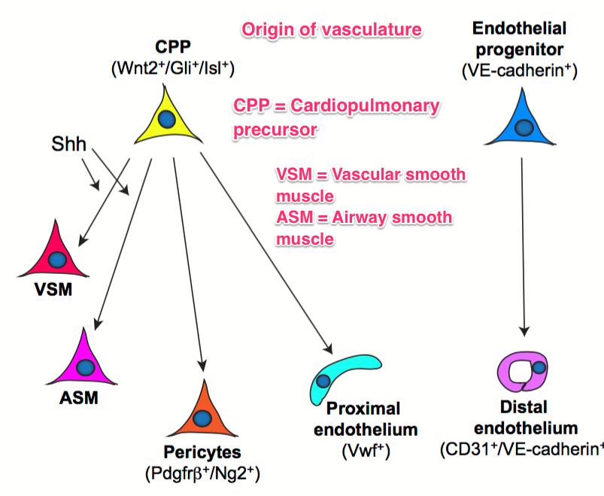

Slide 21
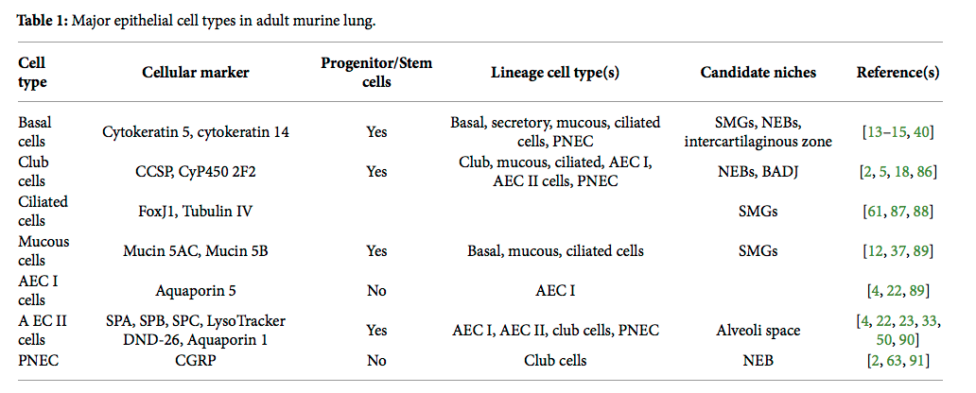

Slide 22
Dynamics of gene expression

Slide 23
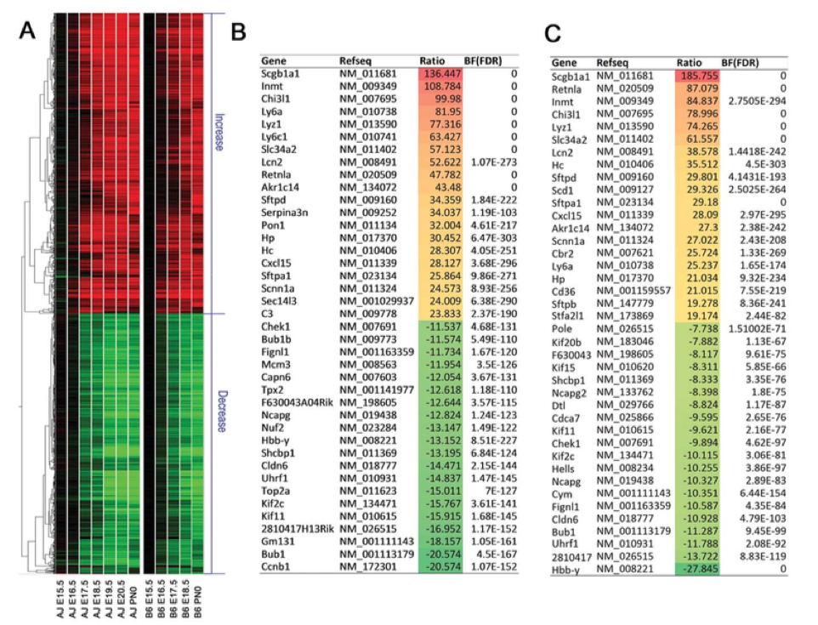

Slide 24
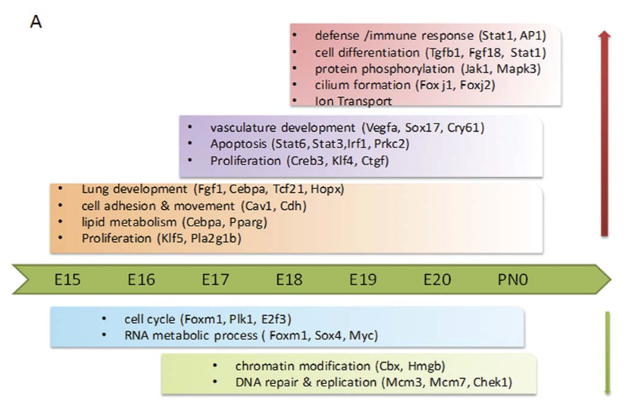

Slide 25
Lung histology examples

Slide 26
http://beta.lungmap.net/breath-immunofluorescence-experiment/?experimentId=LMEX0000000008
Image # 4 (1st 20X)
http://beta.lungmap.net/breath-immunofluorescence-experiment/?experimentId=LMEX0000000073
Image #3 (3rd 20X)
http://beta.lungmap.net/breath-immunofluorescence-experiment/?experimentId=LMEX0000000065
Image #12 (3rd 60X)

Slide 27
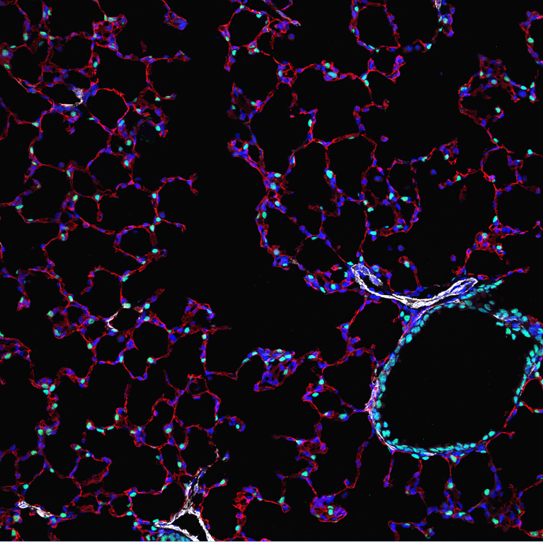

Slide 28
